Slide 1
SOA, Microservices & BPMS
2022-01-18
FHWS

Slide 2
Agenda
Business Process Management & BPMN2
Microservices & Event Driven Architecture
… the real world
BPM @ tech11

Slide 3

Business Process Management

Slide 4
Process Descriptions
How to describe?
MS Word – Prosa
Visio / PowerPoint – Freestyle
Standards:
EPC – event driven process change (EPK – Ereignisgesteuerte Prozessketten)
UML - Unified Modeling Language → Sequence diagrams
BPMN – Business Process Management and Notation

Slide 5
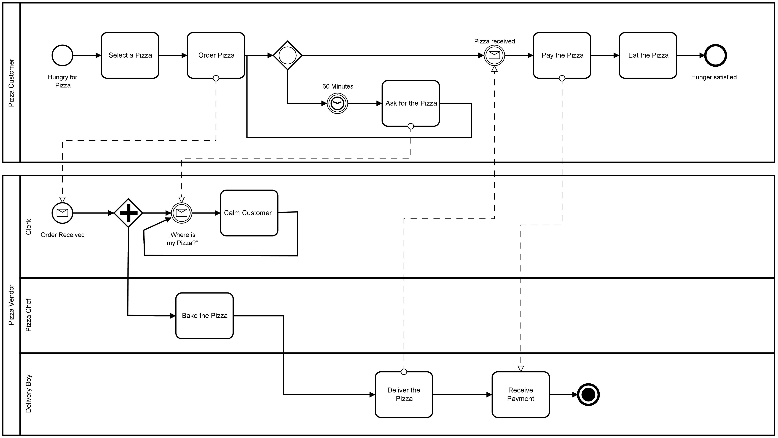
BPMN2
Standardized Process Definitions → Executable

Slide 6
Understanding Business Processes
Simply put, a Business Process is a set of tasks that, once completed in a defined order, accomplishes a defined objective. Each task in a Business Process has clearly defined inputs and outputs. These tasks may require human intervention or may be completely automated.
OMG (Object Management Group) has defined a standard called Business Process Model and Notation (BPMN) for businesses to define and communicate their processes. BPMN has come to be widely supported and accepted in the industry. The Flowable API fully supports creating and deploying BPMN 2.0 process definitions. [Source: baeldung → https://www.baeldung.com/flowable]
Excursion: BPM & RPA → https://weissenberg-group.de/zusammenspiel-von-bpm-und-rpa/

Slide 7
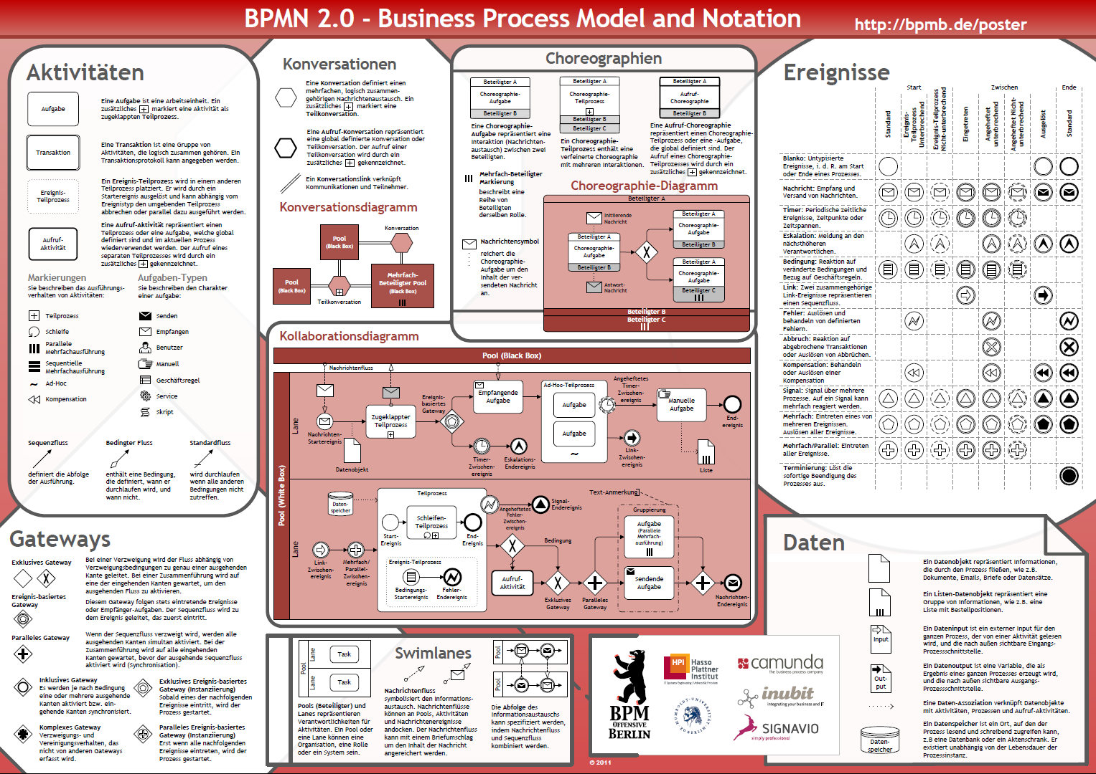

Slide 8

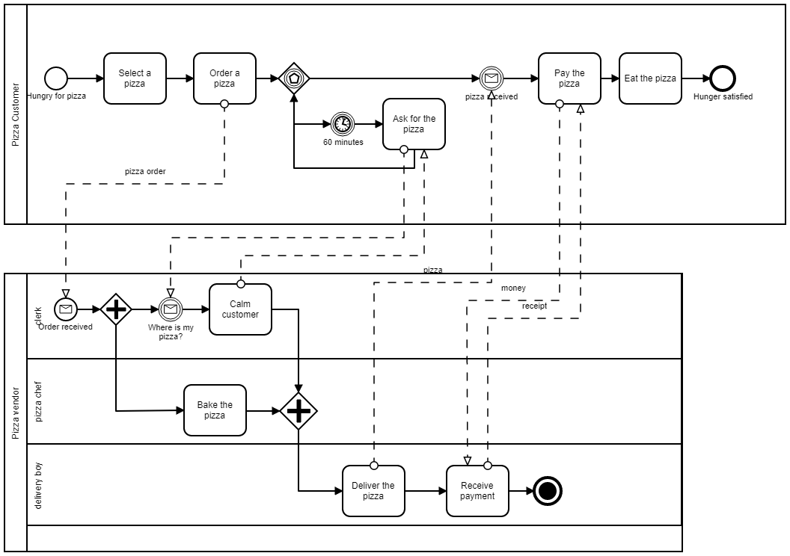
Example: Pizza Ordering Process
[Source: https://camunda.com/de/bpmn/bpmn-examples/ ]

Slide 9
BPMS / Process Automation „Types“
No-Code
https://zapier.com/
https://powerautomate.microsoft.com/
https://kissflow.com/low-code/no-code/
https://www.gbtec.com/resources/no-code-and-low-code-automation/
Low-Code
https://www.pega.com/de/products/platform/case-management
https://kissflow.com/low-code/
https://www.flokzu.com/
Developer Friendly
https://camunda.com/
https://www.flowable.com/
https://www.activiti.org/
https://www.redhat.com/en/resources/process-automation-overview

Slide 10
Demo I 💪💪💪
Screenplay
Setup BPMS (Camunda)
Camunda Demo Processes
New FHWS Processes
Script Tasks
Java Service Tasks
REST API
Change Service Task Order
Add Gateway
https://github.com/MatthiasReining/fhws-bpmn

Slide 11
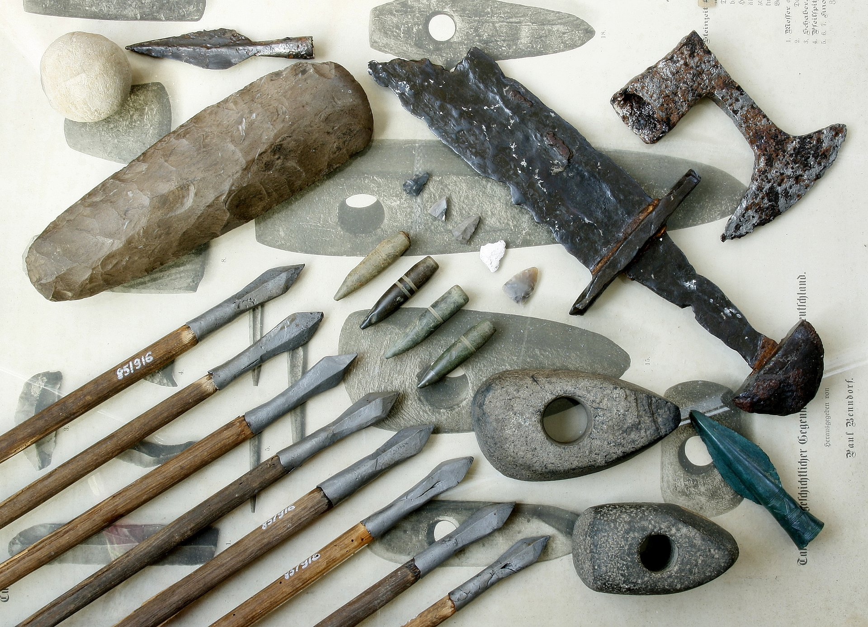
BPMN2 was introduced in
2011
LEGACY???

Slide 12
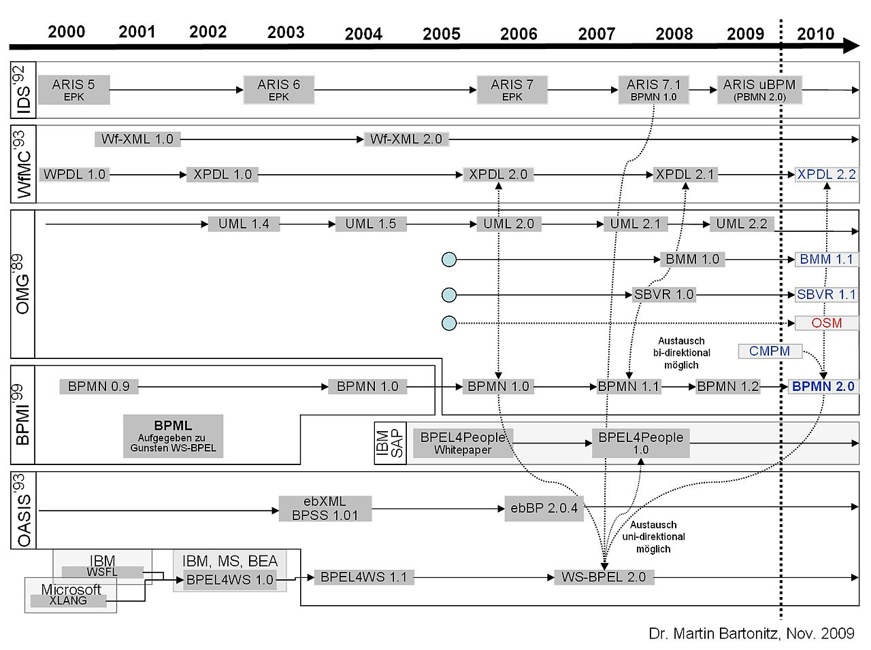
Process Modelling History…

Slide 13

Disadvantages when using BPMS
Centralized business logic
Single point of failure
Finding the right detail level (in your BPMN design)
“Wrong” modelling will lead to unmanageable complexity
Sounds like “old stuff” (legacy)
Often used with ESB (enterprise service bus) → “monster”
No-code BPMS solutions often do not fulfil what they promise OR the requirements grow over time

Slide 14
Microservices & Event Driven Architecture

Slide 15

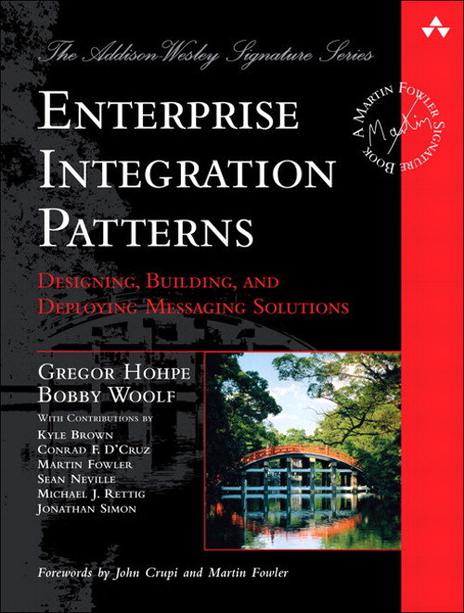
Martin Fowler
… 2003
Refactoring
Unit Testing
CI / CD
Definition of Microservices
…

Slide 16
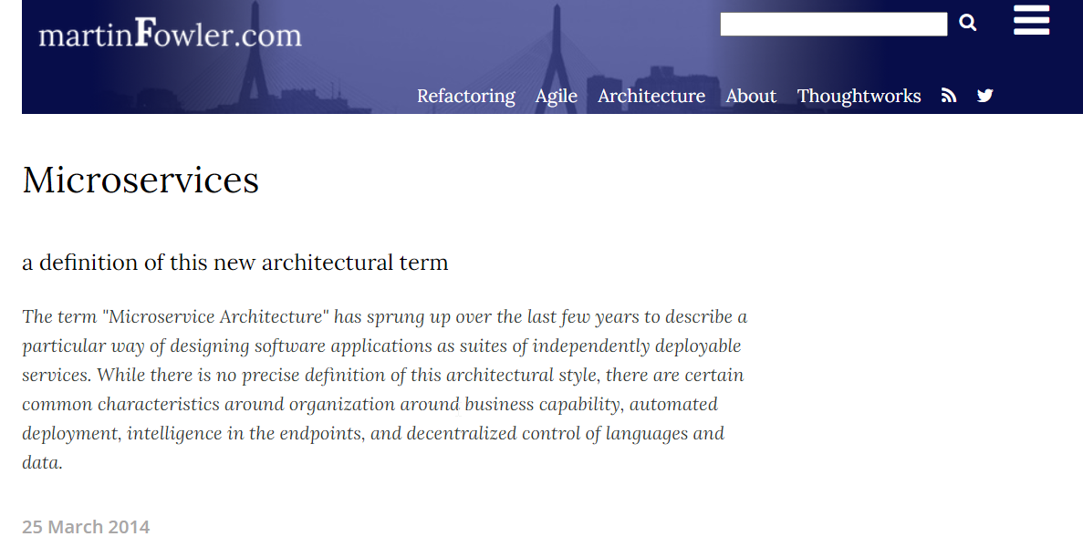
→ https://martinfowler.com/articles/microservices.html

Slide 17

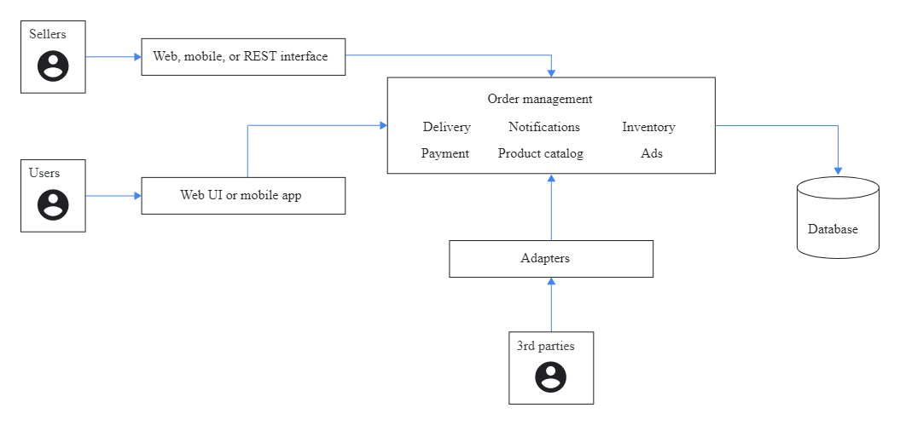
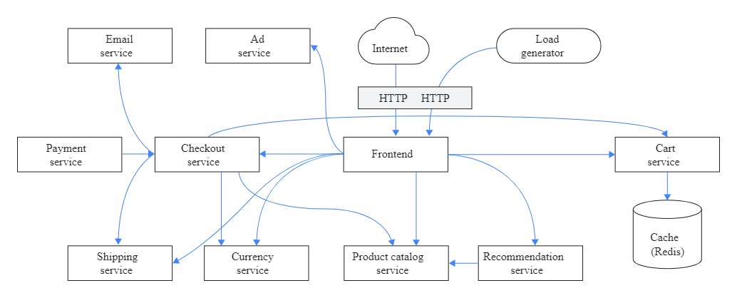
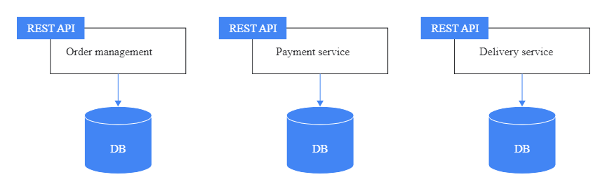
Monolith
→ Microservice
[Source: https://cloud.google.com/architecture/microservices-architecture-introduction]

Slide 18
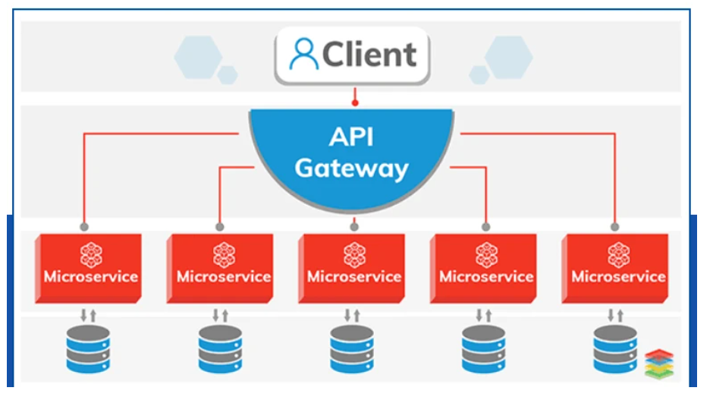
Microservice Architectures (REST)
[Source: https://www.dynatrace.com/news/blog/what-are-microservices/ ]

Slide 19
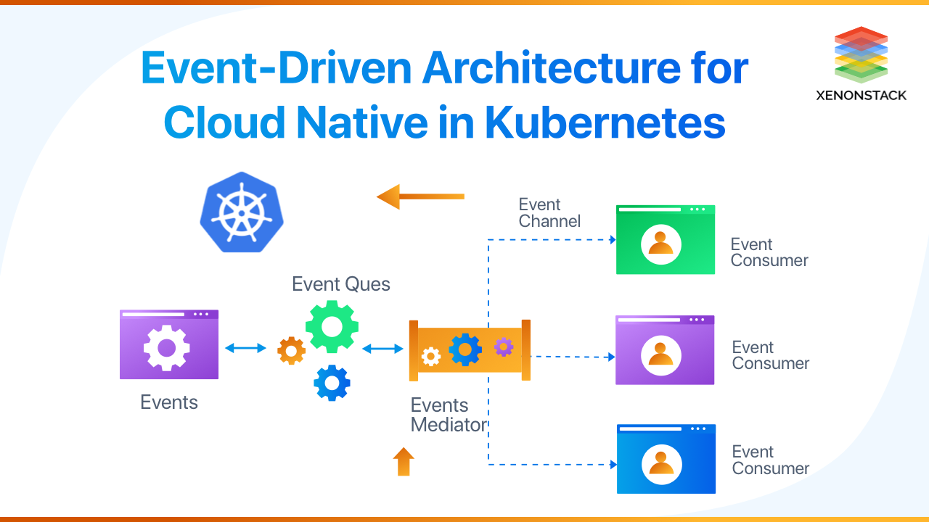
[Source: https://www.xenonstack.com/blog/eda-for-cloud-native-kubernetes]

Slide 20
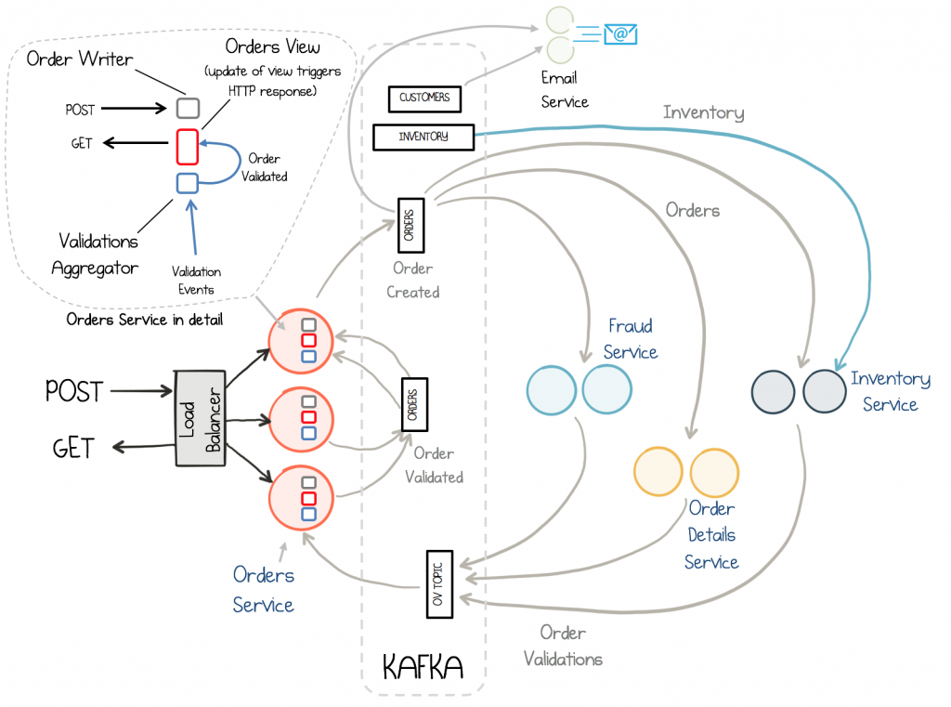
Microservice Architectures (Events)
[Source: https://www.confluent.io/blog/building-a-microservices-ecosystem-with-kafka-streams-and-ksql/ ]

Slide 21
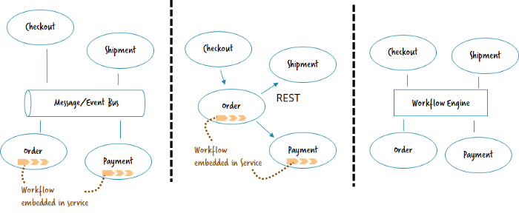
The Microservices Workflow Automation Cheat Sheet (by Bernd Rücker)
[Source: https://blog.bernd-ruecker.com/the-microservice-workflow-automation-cheat-sheet-fc0a80dc25aa ]

Slide 22
the real world…

Slide 23


Slide 24

Software Architecture
Is these your business?
Do you need the same design principles?

Slide 25


Slide 26
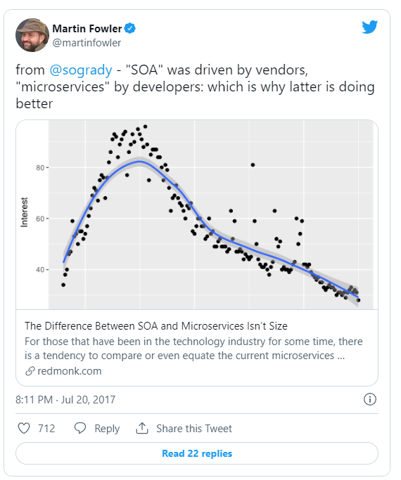
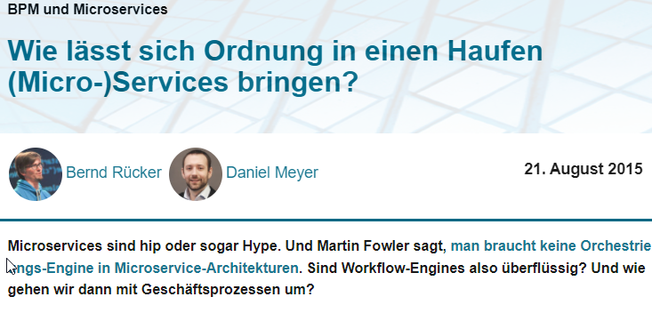
[Source: https://entwickler.de/software-architektur/wie-lasst-sich-ordnung-in-einen-haufen-micro-services-bringen/ ]

Slide 27
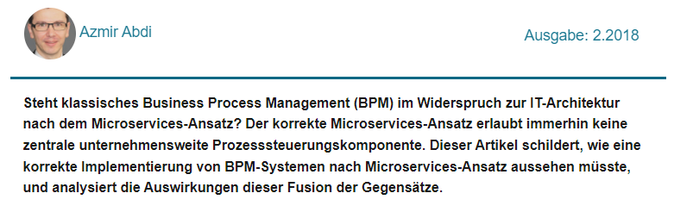
Andersherum betrachtet könnte man sagen, dass SOA und BPM richtig am Platz in Unternehmen sind, bei denen jeder Schritt nach zentraler Planung haargenau umgesetzt werden muss, wo keine ungeprüften Optimierungsaktionen zugelassen sind, zum Beispiel in der stark regulierten Pharmaindustrie.
[Source: https://entwickler.de/microservices/die-ordnung-uber-den-haufen-werfen]

Slide 28
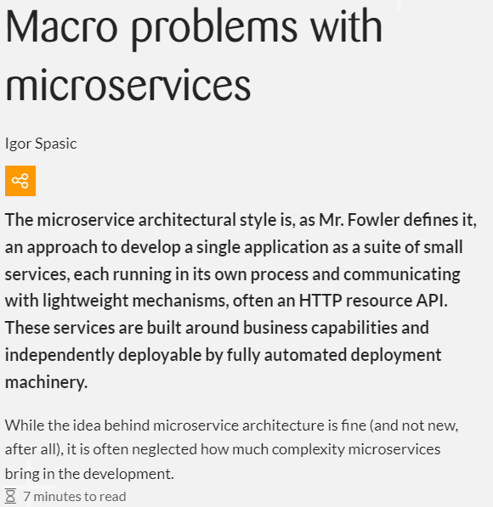
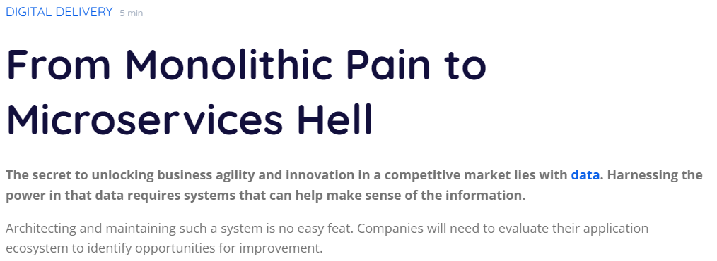
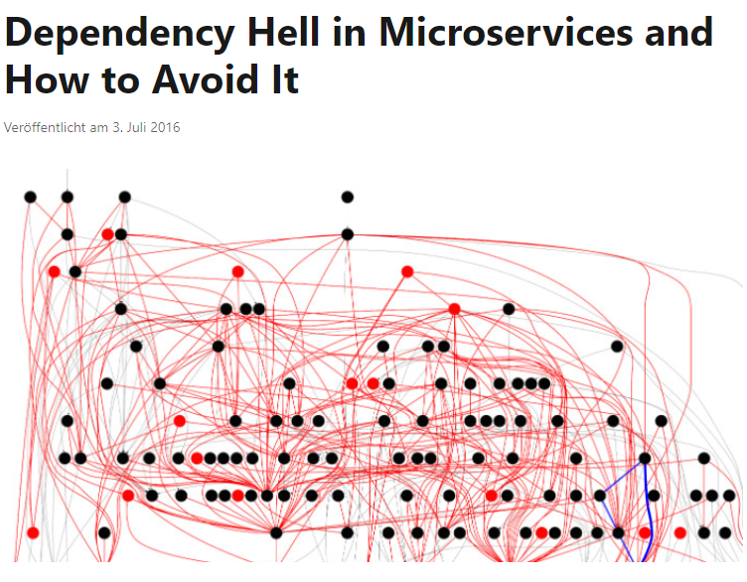
[Source: https://www.adservio.fr/post/from-monolithic-pain-to-microservices-hell ]
[Source: https://www.zuehlke.com/de/insights/macro-problems-microservices ]
[Source: https://www.linkedin.com/pulse/dependency-hell-microservices-how-avoid-nabil-hijazi/ ]

Slide 29
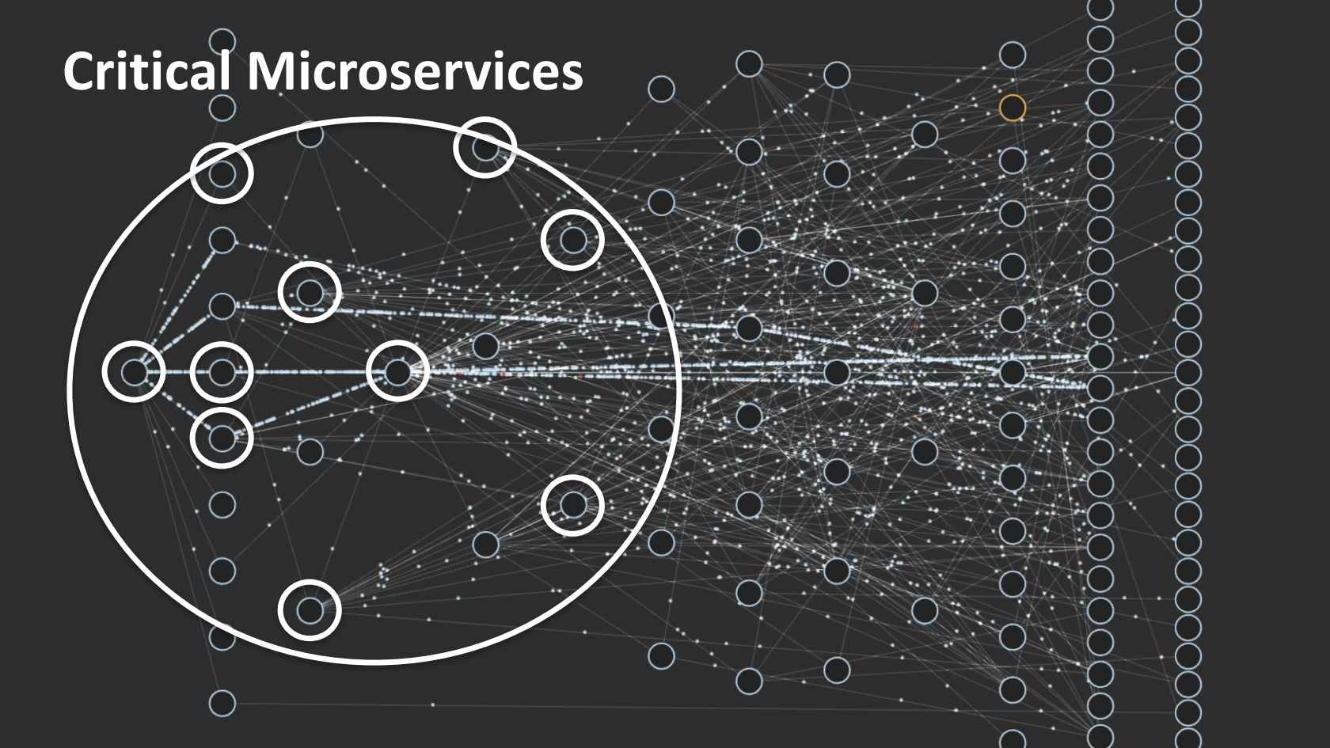
Microservices at Netflix (>1,000)
[Source: https://www.infoq.com/presentations/netflix-chaos-microservices/]

Slide 30

Enterprise Business
Finance, Insurance, … (my business 😉)
Other requirements
Known processes are more important than auto-scaling / HA

Slide 31
… BPMN2

Slide 32
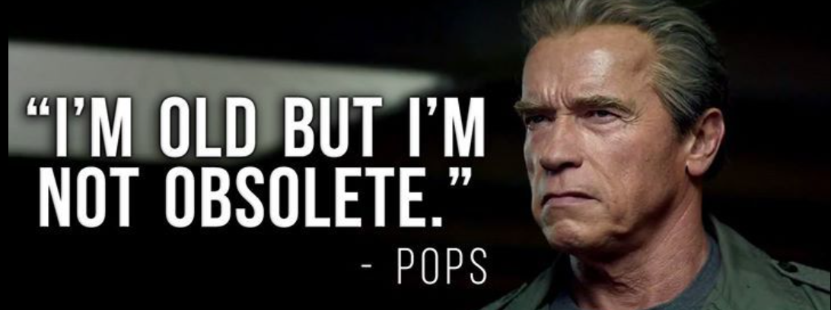
BPMN2.0
Terminator: Genisys
… still trendy
… still growing / becoming more and more popular in the enterprise world.
e.g., Camunda. https://camunda.com/about/customers/

Slide 33
Demo II 💪💪💪
Screenplay
Create Microservices with Quarkus
Link Microservices to BPMN service tasks
Error Handling / Service not available
BPMS as queue
Error boundary event
https://github.com/MatthiasReining/fhws-bpmn

Slide 34

BPM @ tech11
tech11

Slide 35
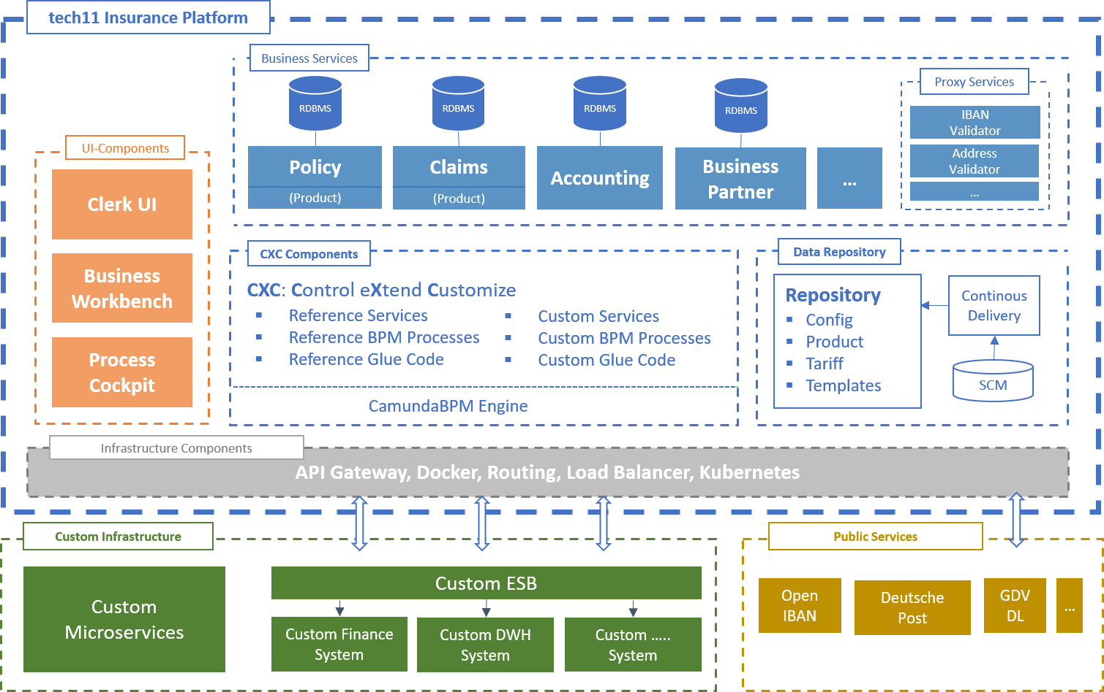
Architecture: tech11 Insurance Platform

Slide 36
SOA based on Microservice Technology

Slide 37
tech11 Insurance Platform
Module Size: Business Design
Modules as Products
API Driven
Idempotent Service Design
Module Orchestration:
Camunda BPMS (as reference)
BPMS as “Customizing Layer”

Slide 38
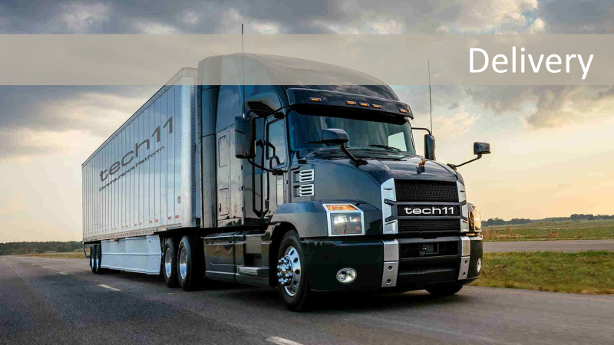

Customizing
meets

Slide 39
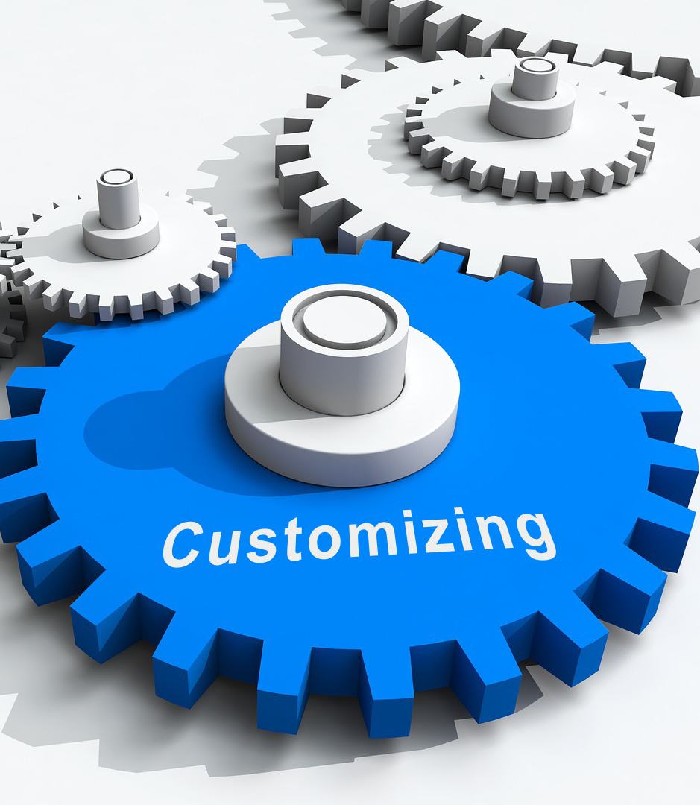
Customizing
Why Customizing?
Individual Insurance Products (e.g., the best E-Bike Insurance)
Individual Processes (faster, leaner, closer to the customer, …)
Product → Customizing → Custom Fit
Starting with a GAP analysis (custom need, tech11 reference)
Discuss with customers (based on BPM diagrams)

Slide 40

Summary
Should I use a BPMS?
→ „it depends“
Custom Solution vs. Product
Is an e2e visibility required?
The “enterprise world” like structured processes
(Normally) you are not Netflix
Respect the KISS principle: keep it simple, stupid
Think about the requirements (including non-functional)
Choose your architecture
Avoid “cargo cult programming”
Depending on the context, BPMS can bring a real added value

Slide 41
sounds interesting? … join tech11

Slide 42

Thank you for your attention

